Slide 1
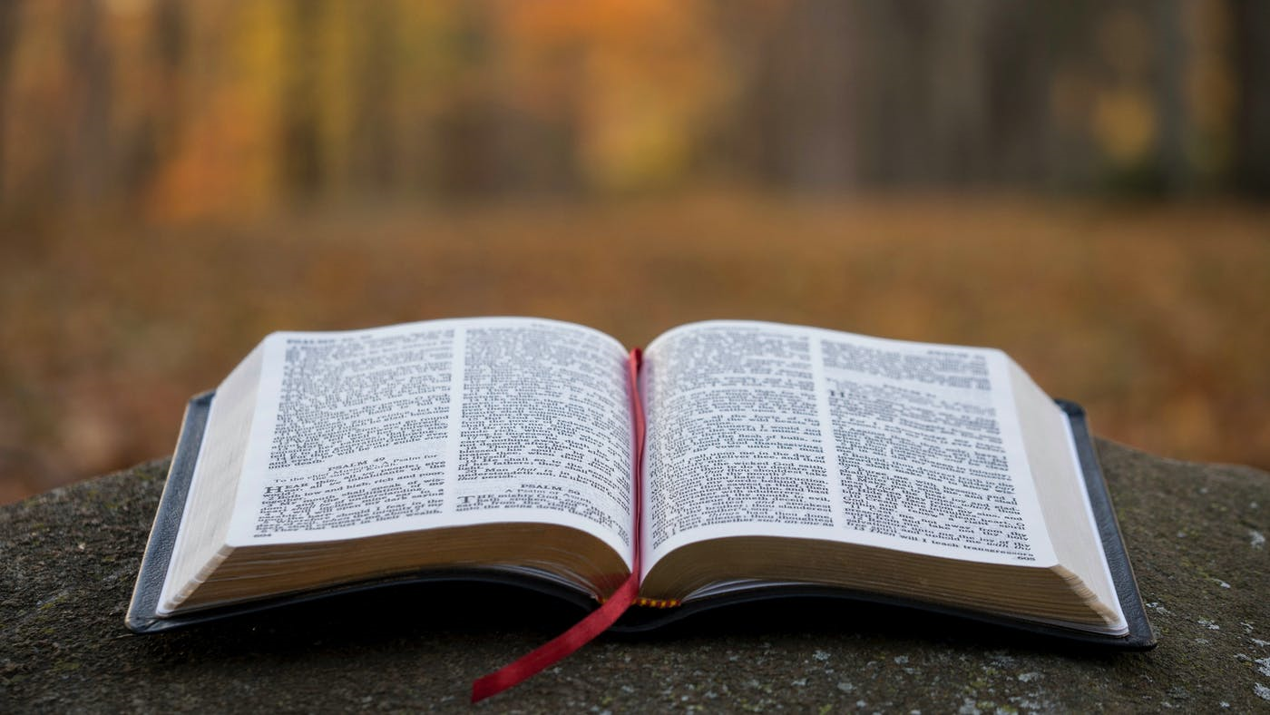
By the Book

Slide 2
2 Timothy 2:15
15 Study to shew thyself approved unto God, a workman that needeth not to be ashamed, rightly dividing the word of truth.

Slide 3
Don’t let this be said about the churches of Christ!
Jeremiah 4:22
22 For my people is foolish, they have not known me; they are sottish children, and they have none understanding: they are wise to do evil, but to do good they have no knowledge.

Slide 4
2 Timothy 3:14-17
14 But continue thou in the things which thou hast learned and hast been assured of, knowing of whom thou hast learned them;
15 And that from a child thou hast known the holy scriptures, which are able to make thee wise unto salvation through faith which is in Christ Jesus.
16 All scripture is given by inspiration of God, and is profitable for doctrine, for reproof, for correction, for instruction in righteousness:
17 That the man of God may be perfect, throughly furnished unto all good works.

Slide 5
Bible Breakout (66)
OLD TESTAMENT = 39
5-Law of Moses
(Gen, Ex, Lev, Num, Deut)
12-History of Israel
(Jos, Jud, Rut, ½ Sam, ½ Kin, ½ Chr, Ezr, Neh, Est)
5-Poetic Books
(Job, Psa, Pro, Ecc, SoS)
5-Major Prophets
(Isa, Jer, Lam, Eze, Dan)
12-Minor Prophets
(Hos, Joel, Amos, Oba, Jonah, Mic, Nah, Hab, Zeph, Hag, Zech, Mal)
New Testament = 27
4-Gospels
(Matt, Mark, Luke, John)
1-Church History
(Acts)
14-Specific Epistles (Letters)
(Rom, ½ Co, Ga, Eph, Phi, Col, ½ Thess, ½ Tim, Titus, Phil, Heb)
7-Hebrew Epistles (Letters)
(Jam, ½ Pet, 1-3 Joh, Jude)
1-Prophesy
(Rev)

Slide 6
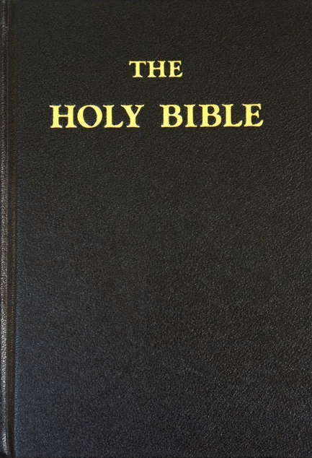
Deuteronomy 4:2
2 Ye shall not add unto the word which I command you, neither shall ye diminish ought from it, that ye may keep the commandments of the LORD your God which I command you.
Deuteronomy 12:32
32 What thing soever I command you, observe to do it: thou shalt not add thereto, nor diminish from it.
Revelation 22:18-19
18 For I testify unto every man that heareth the words of the prophecy of this book, If any man shall add unto these things, God shall add unto him the plagues that are written in this book:
19 And if any man shall take away from the words of the book of this prophecy, God shall take away his part out of the book of life, and out of the holy city, and from the things which are written in this book.

Slide 7
Isaiah 8:20
20 To the law and to the testimony: if they speak not according to this word, it is because there is no light in them.
Isaiah 34:16
16 Seek ye out of the book of the LORD, and read:
Proverbs 30:5-6
5 Every word of God is pure: he is a shield unto them that put their trust in him.
6 Add thou not unto his words, lest he reprove thee, and thou be found a liar.
Luke 4:16-17
16 And he came to Nazareth, where he had been brought up: and, as his custom was, he went into the synagogue on the sabbath day, and stood up for to read.
17 And there was delivered unto him the book of the prophet Esaias. And when he had opened the book, he found the place where it was written,
Is your church in the Bible?
Luke 4:20
20 And he closed the book, and he gave it again to the minister, and sat down. And the eyes of all them that were in the synagogue were fastened on him.

Slide 8
Acts 17:11-12
11 These were more noble than those in Thessalonica, in that they received the word with all readiness of mind, and searched the scriptures daily, whether those things were so.
12 Therefore many of them believed; also of honourable women which were Greeks, and of men, not a few.
When the Bible speaks, we better listen!
1 Peter 4:11
11 If any man speak, let him speak as the oracles of God; if any man minister, let him do it as of the ability which God giveth: that God in all things may be glorified through Jesus Christ, to whom be praise and dominion for ever and ever. Amen.
Trustworthy, Verily,
I Agree!

Slide 9
Ephesians 3:4
4 Whereby, when ye read, ye may understand my knowledge in the mystery of Christ.
2 Timothy 2:15
15 Study to shew thyself approved unto God, a workman that needeth not to be ashamed, rightly dividing the word of truth.
Be a student of the Bible!
School not required (no college or university required)
Diligent in homework (persistent and hard-working)
Self-paced (at your convenience)
Disciplined in the Word
(everything is from God, but not everything is for everyone)

Slide 10
Who is John writing to?
Study Example
1 John 1:8-9
8 If we say that we have no sin, we deceive ourselves, and the truth is not in us.
9 If we confess our sins, he is faithful and just to forgive us our sins, and to cleanse us from all unrighteousness.
What about the sinner's prayer?
John 9:31
31 Now we know that God heareth not sinners: but if any man be a worshipper of God, and doeth his will, him he heareth.
How do I become a “doer”?

Slide 11
Those who have come in contact with the blood!
1 Peter 3:12
12 For the eyes of the Lord are over the righteous, and his ears are open unto their prayers: but the face of the Lord is against them that do evil.
Those who have NOT come in contact with the blood!
Acts 2:47
47 Praising God, and having favour with all the people. And the Lord added to the church daily such as should be saved..
How do we get added to the church?

Slide 12
Directions given to an alien sinner!
Acts 2:38
38 Then Peter said unto them, Repent, and be baptized every one of you in the name of Jesus Christ for the remission of sins, and ye shall receive the gift of the Holy Ghost.
Two things you WILL NOT find in the NT!
An apostle telling an alien sinner to pray
An apostle telling a saved person to be baptized

Slide 13
You can not just be baptized to be saved!
Acts 2:22-24
22 Ye men of Israel, hear these words; Jesus of Nazareth, a man approved of God among you by miracles and wonders and signs, which God did by him in the midst of you, as ye yourselves also know:
23 Him, being delivered by the determinate counsel and foreknowledge of God, ye have taken, and by wicked hands have crucified and slain:
24 Whom God hath raised up, having loosed the pains of death: because it was not possible that he should be holden of it.
Acts 2:33
33 Therefore being by the right hand of God exalted, and having received of the Father the promise of the Holy Ghost, he hath shed forth this, which ye now see and hear.

Slide 14
Obedience is more than just baptism!
If you have been converted to Jesus, then you will fully obey!
Colossians 1:21-23
21 And you, that were sometime alienated and enemies in your mind by wicked works, yet now hath he reconciled
22 In the body of his flesh through death, to present you holy and unblameable and unreproveable in his sight:
23 If ye continue in the faith grounded and settled, and be not moved away from the hope of the gospel, which ye have heard, and which was preached to every creature which is under heaven; whereof I Paul am made a minister;

Slide 15
